Slide 1

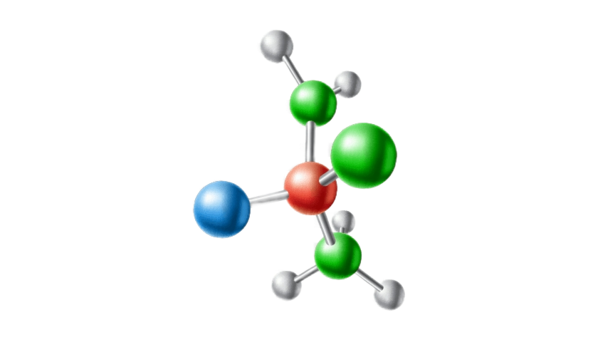
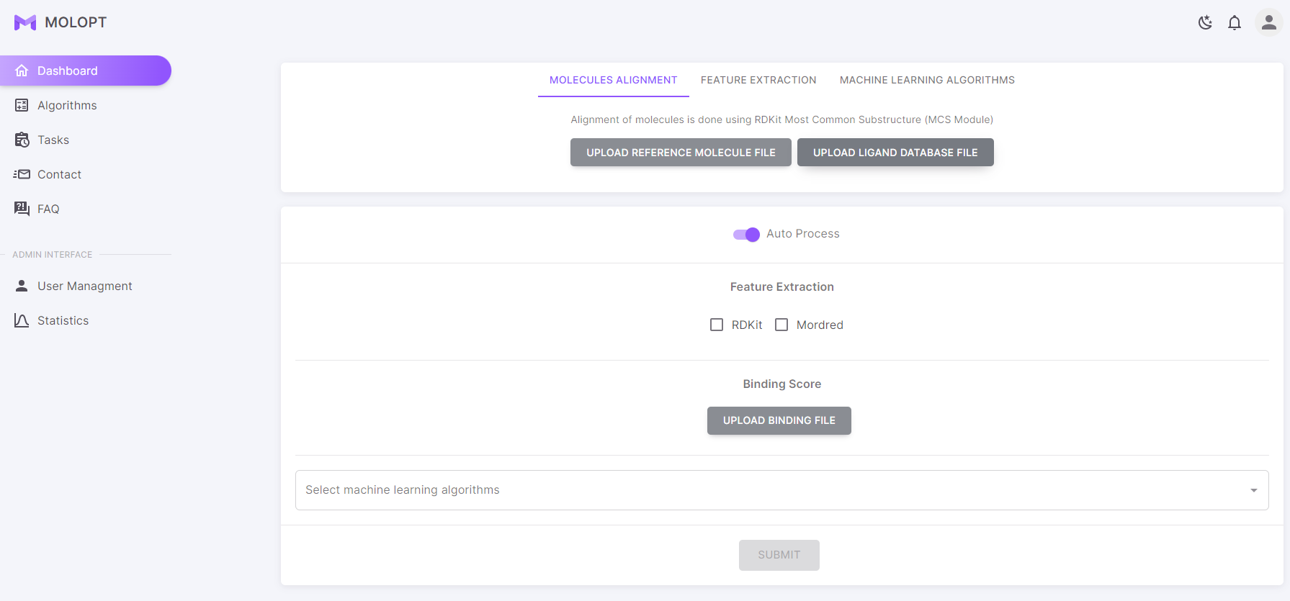
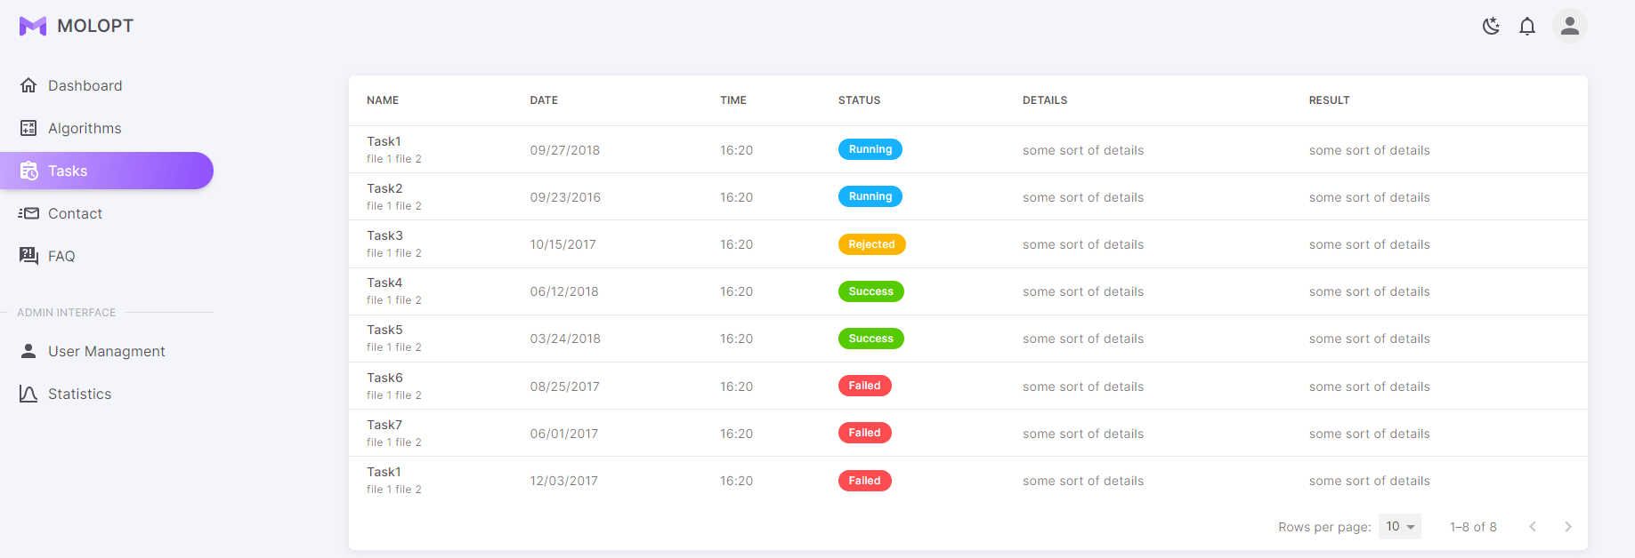
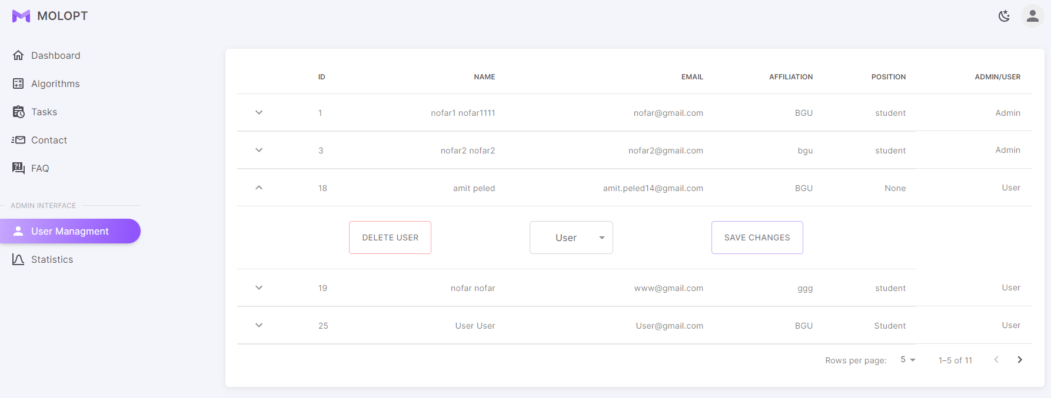

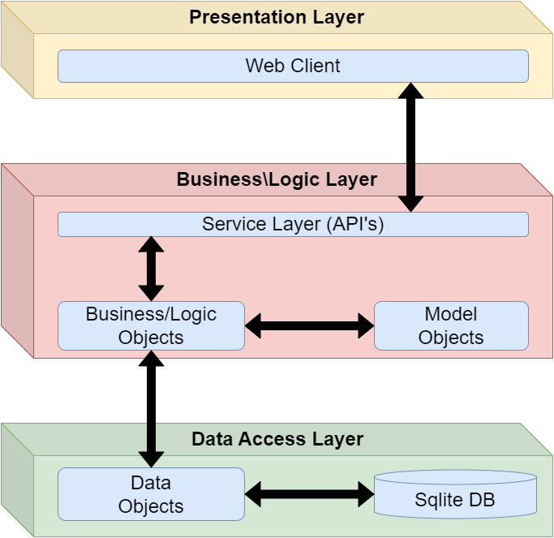

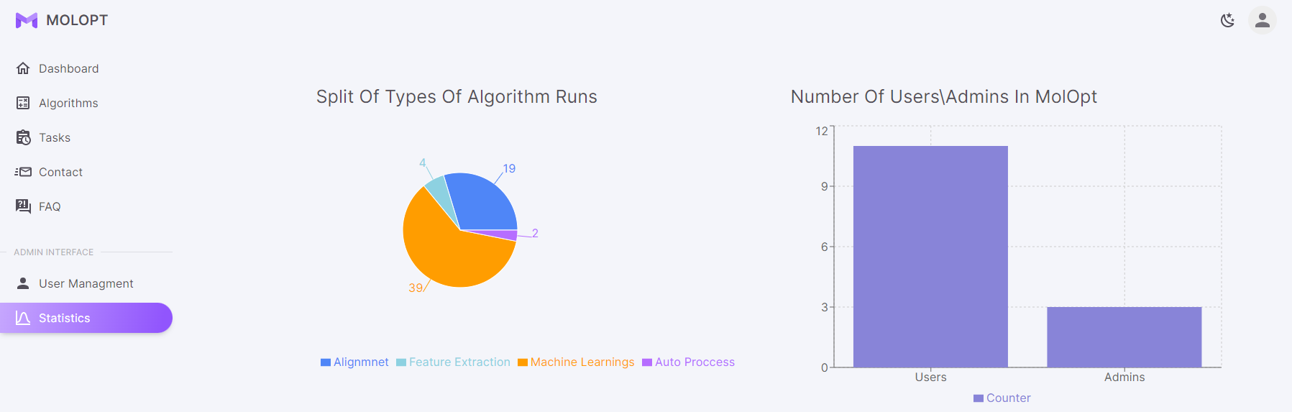
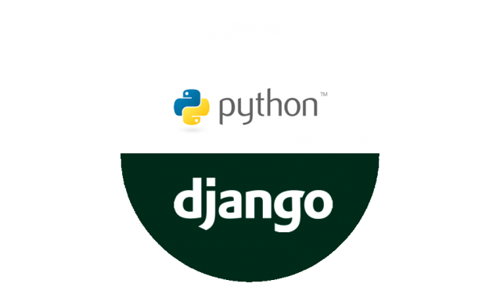
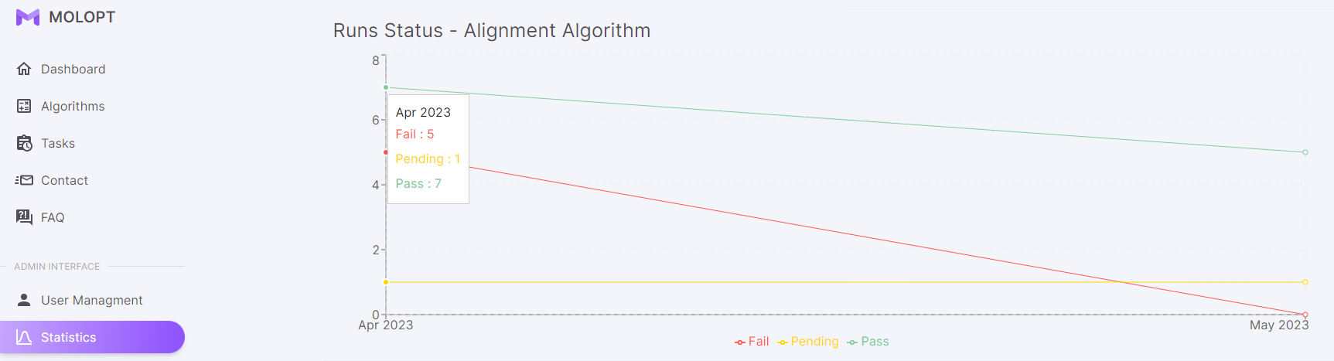

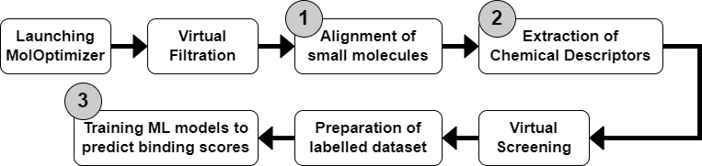



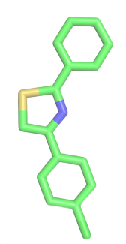



373-23-02
הפקולטה למדעי ההנדסה
התוכנית להנדסת תוכנה
MolOptimizer
Amit Peled, Daniel Piro, Shahar Alon & Nofar Rozenberg
Advisors: Prof. Kobi Gal, Dr. Niv Gilboa, Prof. Robert Moskovitch, Yuval Moskovitch, Ehud Sivan \ Dr. Barak Akabayov
Abstract
Features & Screenshots
MolOptimizer is a software engineering project which created as part of the Ben Gurion University software engineering program.
MolOptimizer (MolOpt( was Developed at Akabayov Research Laboratories at BGU, Under the supervision of Dr. Barak Akabayov.
The main purpose of MolOpt is to be used by researchers working in the field of small fragment-based inhibitors and is intended to be helpful in optimization of ligand databases.
Our Project
At the beginning, MolOpt was a very basic flask-based web package which can be used for:
Alignment of large ligand datasets.
Extracting large volume of Chemical Descriptors.
Training Machine Learning models to predict binding scores.
All of those could ran only locally on the labs’ computers.
Our work included:
Keeping, Upgrading & Optimizing the Alignment, Feature Extractions & ML Algorithm Runnings.
Converting MolOpt to a global and user-friendly web-application.
Updating the old flask application to a modern and new Material UI & React JS and Django python application.
Adding users’ management & algorithm runs’ management.
System Architecture
Flow
Technologies

